Slide 1
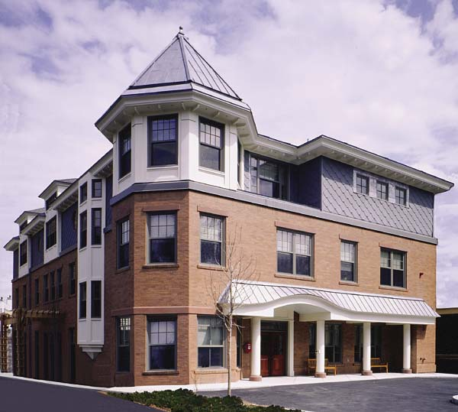
Home and Escort Linkage Program (H.E.L.P.) at the Brookline senior Center
Katie McClean, LICSW

Slide 2

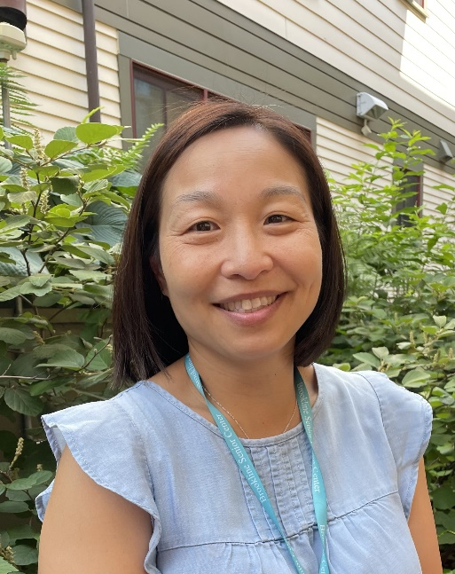
H.E.L.P. Staff
Katie McClean, LICSW
617-730-2755
kmcclean@brooklinema.gov
Anne Essaran, LICSW
617-730-2754
aessaran@brooklinema.gov
H.E.L.P. Line: 617-730-2752

Slide 3
H.E.L.P. Program
The Home and Escort Linkage Program (H.E.L.P.) is a home care service designed and sponsored by the Brookline Council on Aging. For over 30 years, the goal of this program is to provide affordable, reliable, and flexible home care services to older adults living in Brookline.
Services provided by H.E.L.P. workers include:
Laundry
Meal Preparation & Light Cooking
Grocery Shopping
Errands
Medical Escort
Companionship/Respite Care
Very Light Housekeeping
Odd Jobs/Organizing
The H.E.L.P. Program
DOES NOT ASSIST
with tasks that include:
Heavy Cleaning,
Personal care (bathing, toileting),
OR
Medication management
PROGRAM FEE: $20 PER HOUR
WITH A 2 HOUR MINIMUM FOR SERVICES
*payment goes directly from client to worker*

Slide 4
Enrolling in the program
In order to receive services from H.E.L.P., participants must be:
1. a Brookline resident
2. Age 60 and above
In order to enroll, you must make an appointment with Katie or Anne. They will come to your home for an intake meeting, which typically takes between 30 and 60 minutes. Some example intake questions are:
1. What is your date of birth?
2. Who is your emergency contact?
3. What services would be helpful for you at this time or in the near future?
H.E.L.P. Line: 617-730-2752

Slide 5
Once THE INTAKE IS COMPLETE…
Once the intake is completed, Katie and/or Anne will match you with a worker!
Workers have gone through their own intake process with us, including an interview, orientation, CORI background check, and reference checks.
Workers and clients work together to schedule visits, however, clients should always feel free to call Katie and Anne directly with general program questions or support.
*Payment goes directly from clients to workers via cash or check* *The current rate is $20 per hour*

Slide 6
Trusted transportation program (TTP/ICARE)
The Council on Aging receives an ITNAmerica ʺTrusted Transportation Partnerʺ grant, with support from Regeneron Pharmaceuticals. Through this grant, the H.E.L.P. program provides free transportation and medical escort services for Brookline residents to scheduled eye care appointments in the Greater Boston area.
To schedule transportation and/or a medical escort for an eye care appointment specifically, you need to call the H.E.L.P. line AT LEAST 1 BUSINESS WEEK before your scheduled appointment.
*A home visit to complete a H.E.L.P. intake is required to access this program*
H.E.L.P. Line: 617-730-2752

Slide 7
BSC Medical transportation program
The Brookline Senior Center can provide FREE non-emergency medical transportation services to older residents using existing taxi services in the area.
Requests can be left on the Brookline Senior Center Medical Transportation Line at 617-879-4878 at least 3-30 business days in advance of the appointment. Please leave your name and phone number with detailed appointment information. Requests will be confirmed within 24 hours.
This service is curb-to-curb and available for rides within the Town of Brookline and to select medical facilities (including the Longwood Medical Area, Harvard Vanguard-Kenmore, Mass General, Mass Eye & Ear, Faulkner Hospital, Boston Medical Center, the VA Hospital, and St. Elizabeth’s).
Hours are Monday - Friday from 9:00am-5:00pm.
Note: Medical transportation is not available on days when the Senior Center is closed. This service provides both shared and individual rides.
For more transportation information, please call
Maria Foster, Transportation Coordinator:
617-730-2644
https://www.brooklineseniorcenter.org/services/transportation/

Slide 8
Alternative/additional home care resources: friendshipworks
FriendshipWorks is a local nonprofit whose mission is to provide support, companionship, and connection to isolated older adults in the Greater Boston area. Some of their programs include:
Friendly Visiting: Friendly Visitors develop one-on-one relationships with older adults. They visit once a week to drink coffee or tea, share stories, go for walks or do errands together or assist with small tasks.
Medical Escorts: Medical Escorts offers comfort, reassurance, and mobility/navigation assistance to elders beginning inside the home, continuing to the doctor’s office and appointment room, and ending with a safe return back inside the home.
Friendly Helpers: Volunteers provide short-term assistance to older adults who need help with specific tasks. Activities might include: helping with organization, seasonal tasks, errands, or picking up library books.
All FriendshipWorks matches are volunteers, so there is no cost for services!
For more information, please call FriendshipWorks: 617-482-1510

Slide 9
Alternative/additional home care resources: springwell
Springwell is a private, non-profit organization that has been creating, managing, and coordinating a wide range of services for more than 45 years. Some of these services include:
Home Delivered Meals
Friendly Visiting Volunteers
Information & Referral
In Home Services, which could include cleaning support, companionship, homemaking, respite care, laundry support, and personal care support. Additionally, this program could provide personal emergency response systems and medication dispensing systems.
*cost of care depends on income*
For more information, please call Springwell: 617-926-4100

Slide 10
Alternative/additional home care resources:
Private pay home care services
There are many private home care agencies that provide home care services to Brookline residents for a fee. The current rates are $40-60/hour. We recommend calling multiple agencies when looking for home care support so you can compare rates, requirements, and services. Below are a few important questions to consider;
1. Timelines: How long would they need to fill the schedule you request?
2. Minimum hours: Most agencies have a 3, 4, 6, or 8 hr. minimum for shifts.
3. Replacements: What is the likelihood that they would be able to find coverage for a caregiver
who called out last minute or was a no-show?
4. Notice: How much notice do you need to provide to reduce care or terminate services?
5. Retainer: How much money does the company require you to put down in order to start care? It is typical
for agencies to ask for two weeks of the proposed schedule.
6. Answering service: Most caregiving companies have an after-hours number to call outside of business
hours. Is their number answered by a service (where you get a different person every
time) or a staff member (important for consistency)?
*A list of local private pay agencies can be obtained by calling the H.E.L.P. Line: 617-730-2752*

Slide 11
P.a.r.c. program
Parking Access for Resident’s Caregiver (P.A.R.C.) is a service provided through the Brookline Council on Aging, in cooperation with the Town of Brookline Transportation Department. The goal of this program is to provide assistance in obtaining temporary parking permits for caregivers when they are visiting Brookline residents for longer than 2 hours or overnight.
The use of this service is free of charge.
Parking permits are temporary, and will need to be renewed every six (6) months.

Slide 12
p.a.r.c. Process
In order to obtain a temporary parking permit, you must call/email Katie or Anne with the following information:
Brookline resident’s name, address, and phone number
Caregiver’s name, car make/model, and license plate number/state of registration
Reason for need
Katie or Anne will submit your application and letter to the transportation department. Permits can be picked up at the transportation department (Town Hall, 4th Floor) the next business day. Please note that permits CANNOT be mailed at this time.

Slide 13
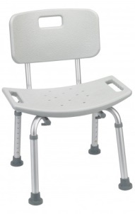
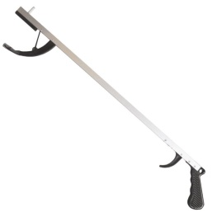
Equipment loan fund (E.l.f.)
The Equipment Loan Fund (E.L.F.) program is a service provided through the Brookline Council on Aging. The goal of this program is to facilitate the exchange, donation, and loan of gently used durable medical equipment at no cost.
Items for loan include:
Walkers
Canes
Crutches
Wheelchairs
Bedrails
Shower Chairs
Tub Transfer Benches
Raised Toilet Seats
Commodes
Shoe Horns
Grabbers
Hearing Aid Batteries
Incontinence Supplies, including bed pads and pull ups
Need an item? Call the h.e.l.p. line
617-730-2752

Slide 14
H.E.L.P. Line
617-730-2752
Katie McClean, LICSW
kmcclean@brooklinema.gov
617-730-2755

